Slide 1
Azure Resource Manager in A Serverless World

Slide 2



Eldert Grootenboer
@egrootenboer

Slide 3

Cloud Migration
Notes:
2

Slide 4










Cloud native
Platform
Event Grid
Logic Apps
Functions
Manage all events that can trigger code or logic
Design workflows and orchestrate processes
Execute your code based on events you specify
API Management
Container Instances
Application Insights
Scalable API gateway for securing, publishing, and analyzing APIs
Run application containers in the cloud with a single command
Extensible Application Performance Management service
Database
Storage
Security
IoT
Analytics
Intelligence
Notes:
Pay as you go
Infinite scale
Don’t do infrastructure anymore

Slide 5
Infrastructure as Code (IaC) is the management of infrastructure (networks, virtual machines, load balancers, and connection topology) in a descriptive model, using version control to store the files.
Notes:
Or said another way. IaC is taking the environment upon which you intent to run your application and codifying it. The code is stored in version control and acted on using a CI/CD pipeline. No manual steps are taking in the portal to provision an environment.

Slide 6
Why Infrastructure as Code
Review changes
Cattle, not pets
Consistency
Reduce human error

Slide 7

But what about serverless and IaC?

Slide 8

IaC on Azure
Notes:
7

Slide 9
Many options
Azure Resource Manager Templates (ARM)
Azure CLI
PowerShell
Code (SDKs)
Terraform
Ansible
Chef
Puppet

Slide 10
Benefits of ARM
First class citizen
Desired-state deployment
Faster deployments
DevOps
Common interface
Notes:
Resource group
Subscription
Management Group
Tenant
Purpose of Slide
Discuss basic benefits of ARM
Notes
ARM does desired-state deployment of resources. It does not do desired-state configuration inside these resources (e.g., VMs), although it can initiate the process of desired-state configuration.
Faster Deployments – ARM can deploy in true parallel as compared to semi-sequential in ASM
RBAC is fully integrated with AAD – and is a long-requested feature.
Resource-provider model is intended to be fully extensible.
Common interface for Azure and Azure Stack – When Azure Stack is released, same API model for on-premises and Cloud

Slide 11

Templates
Notes:
10

Slide 12
Template structure
{
"$schema": "https://schema.management.azure.com/schemas/2019-04-01/deploymentTemplate.json#",
"contentVersion": "1.0.0.0",
"parameters": {},
"variables": {},
"resources": [],
"outputs": {},
"functions": []
}
Notes:
Describe the various fields

Slide 13
ARM Template characteristics
Parameterized
Idempotent
Simple or complex resources
Sequencing
Nesting
Linking

Slide 14
Best practices
Don’t overuse parameters
Use well-chosen defaults
Utilize variables for re-use
Apply tags from templates
Derive values using functions
Use modular templates
Minimize duplicate resources
Notes:
Only use parameters when you need input which can not be derived
Use resourceId and uri
Minimize: Use copy() and conditionals

Slide 15

Authoring
Notes:
17

Slide 16
Visual Studio Code
ARM Templates extension and language
Intellisense
Syntax highlighting
Snippets

Slide 17
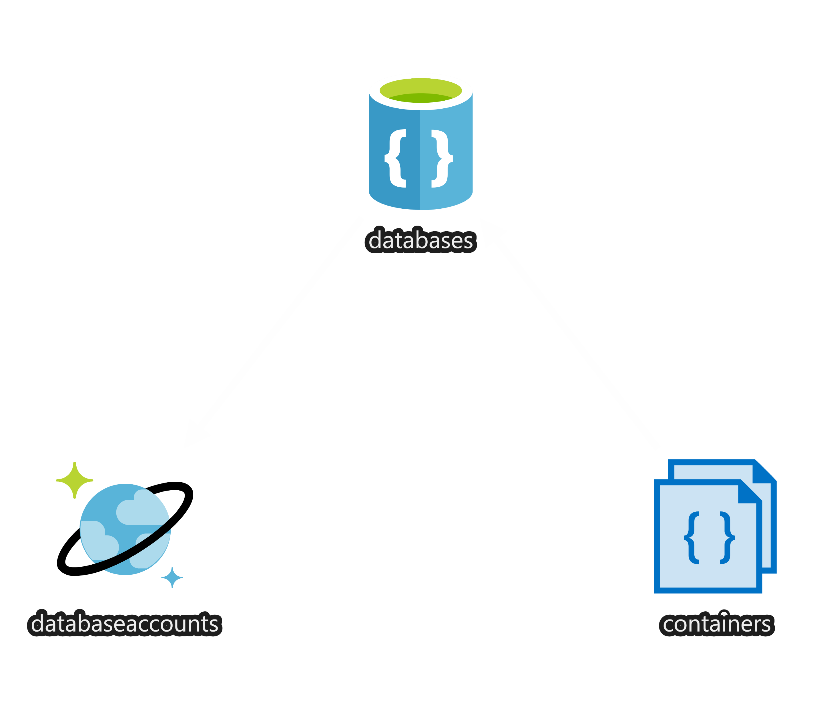
Demo
Notes:
20
Show usage of snippets
Show completed Cosmos DB account template
Name from parameter using default value created with uniqueString
Show in VS Code using visualizer
Deploy through portal

Slide 18

From portal to template
Notes:
25

Slide 19
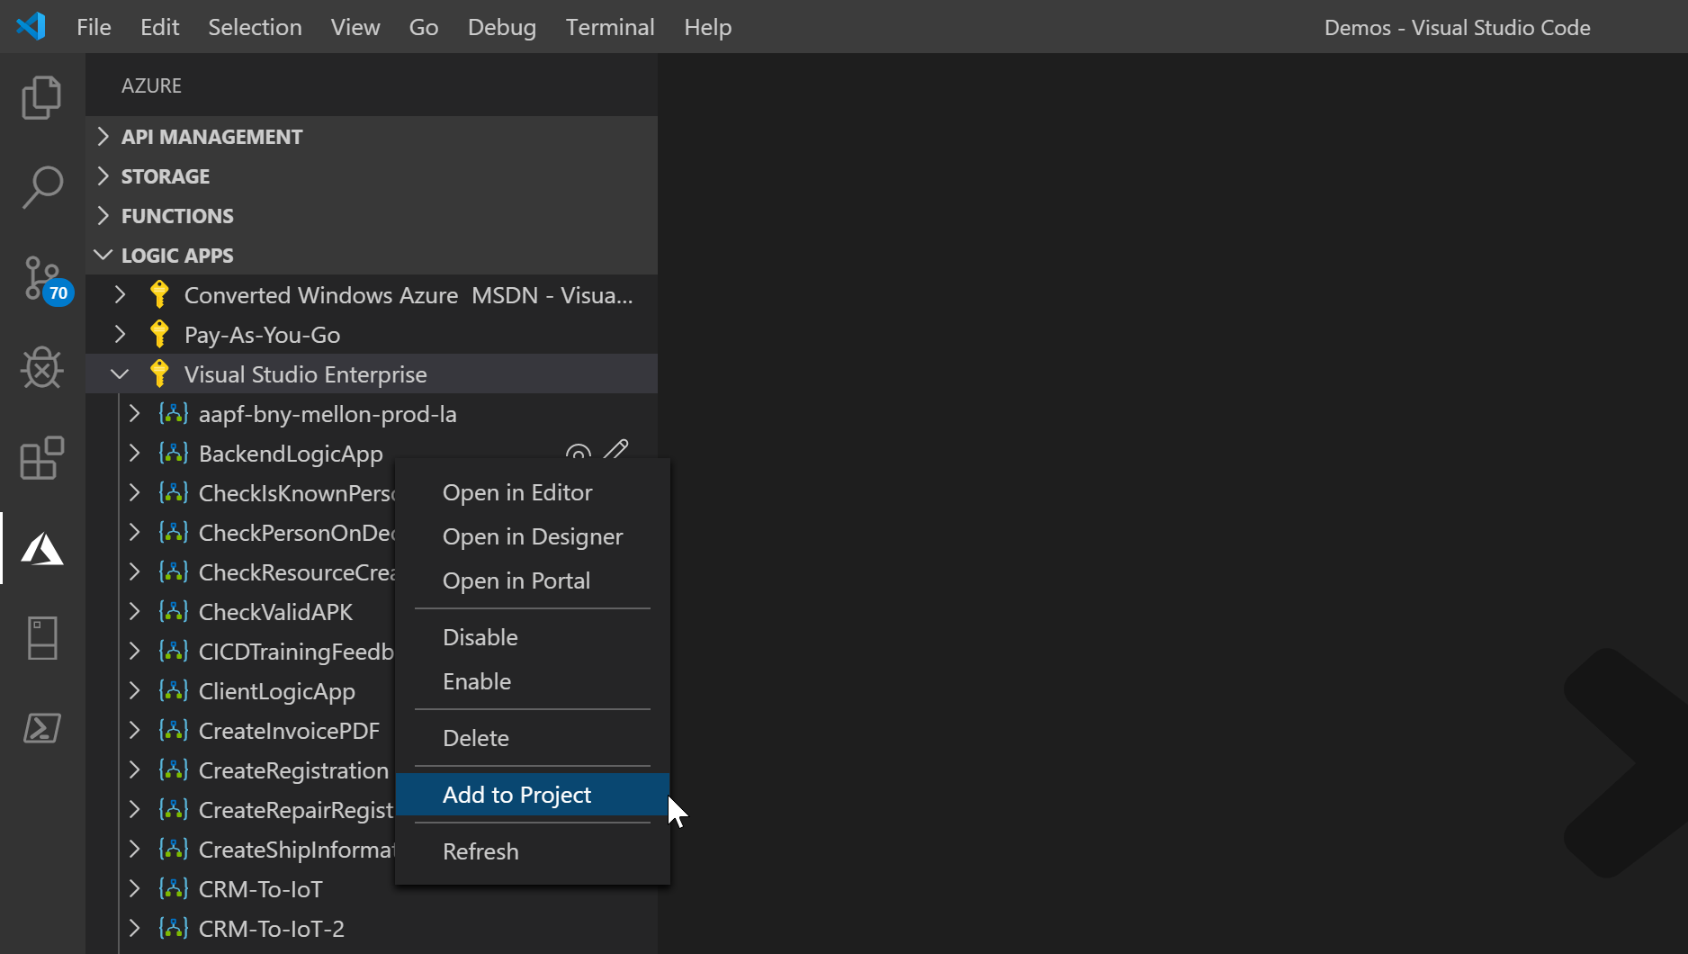
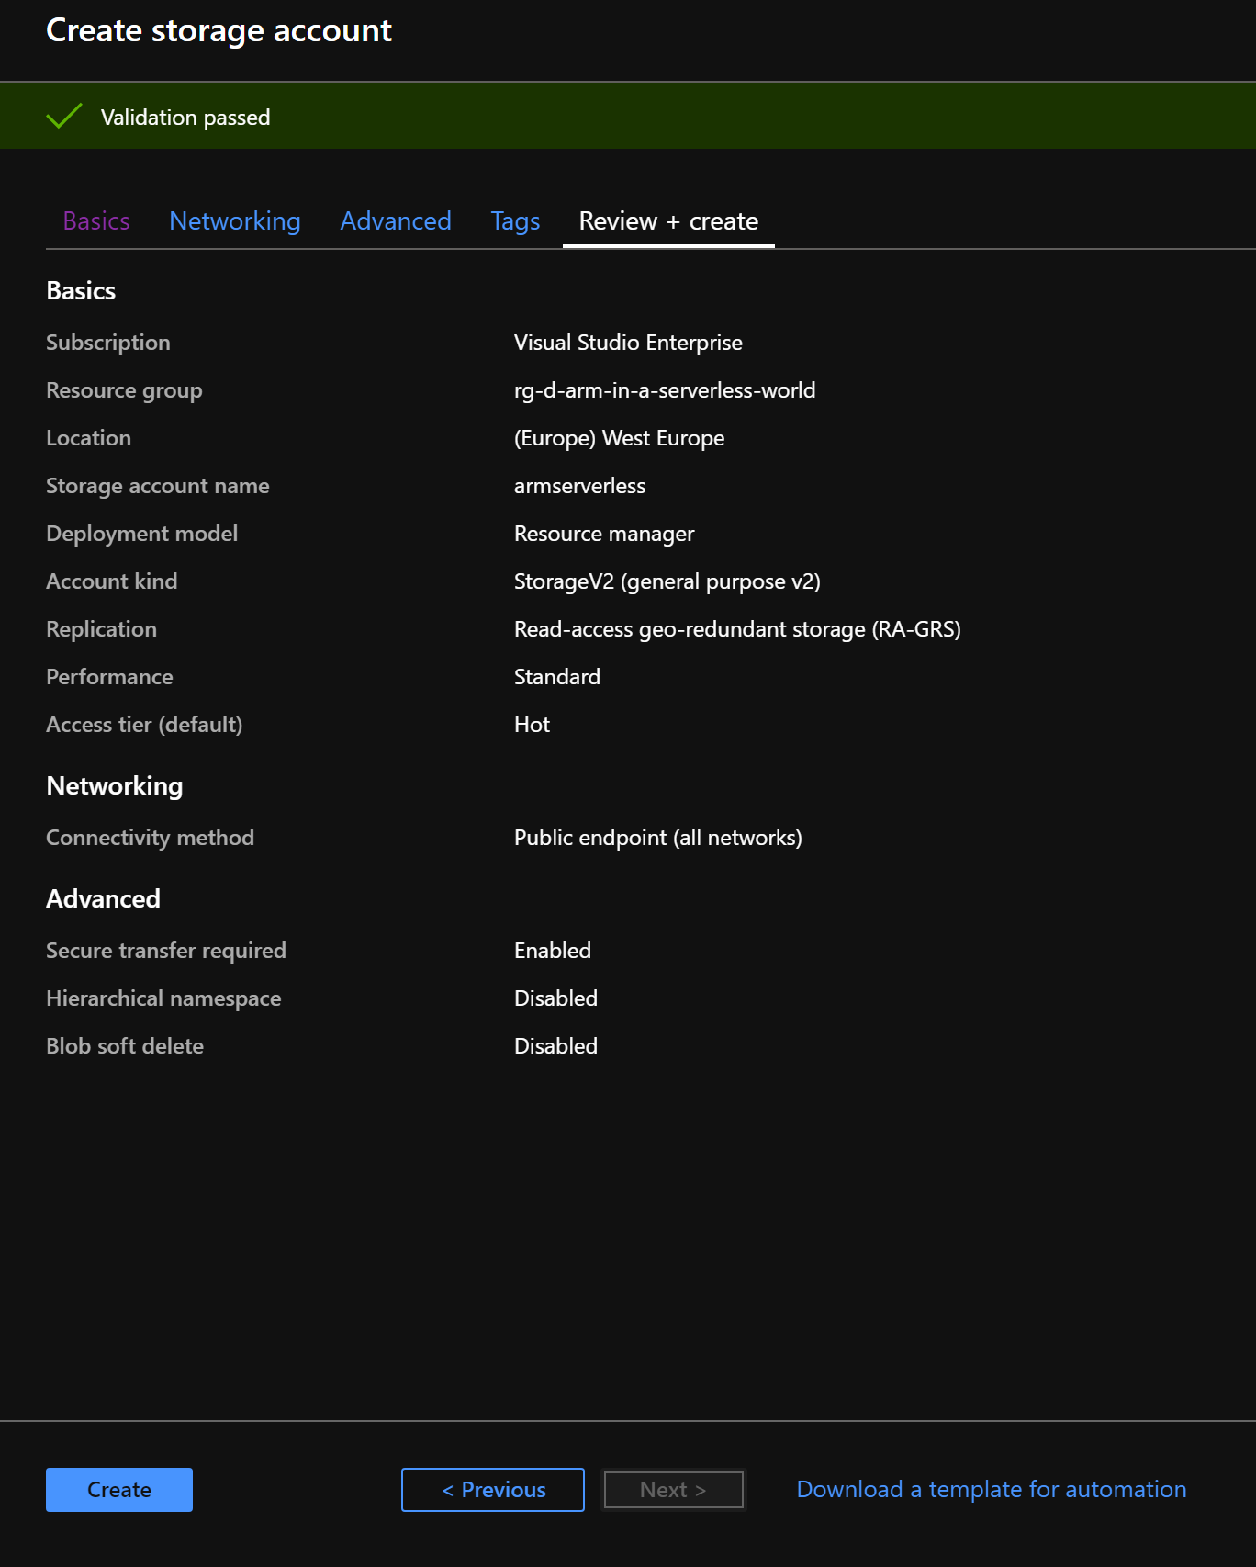
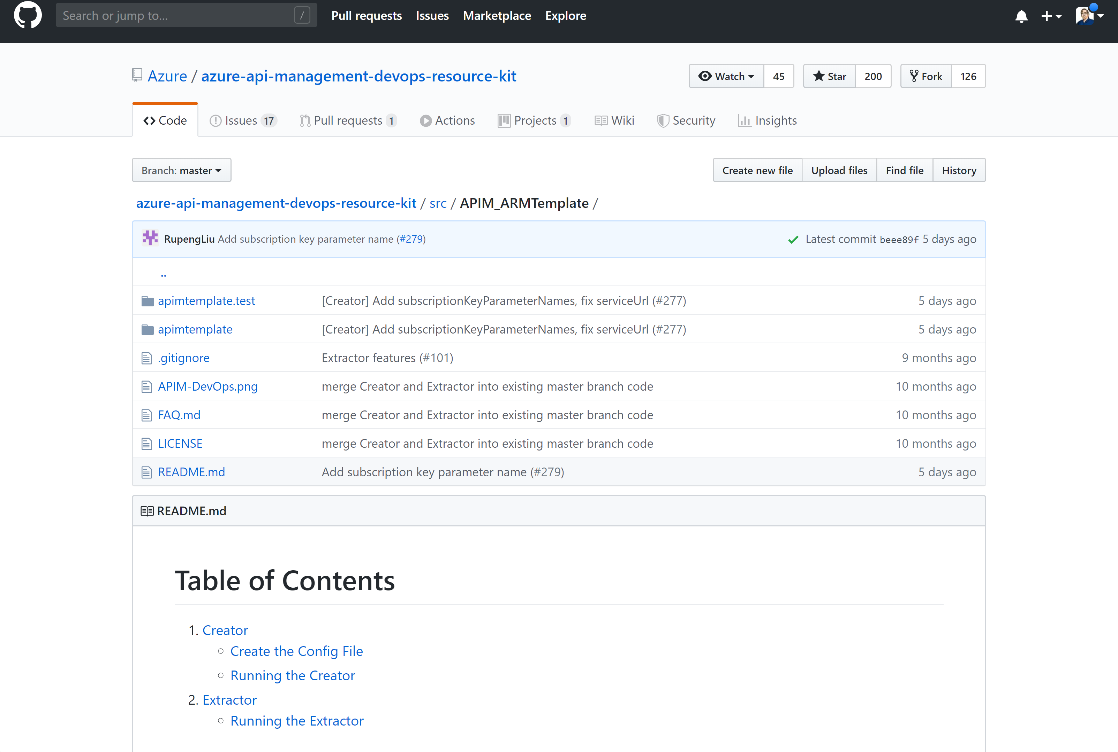
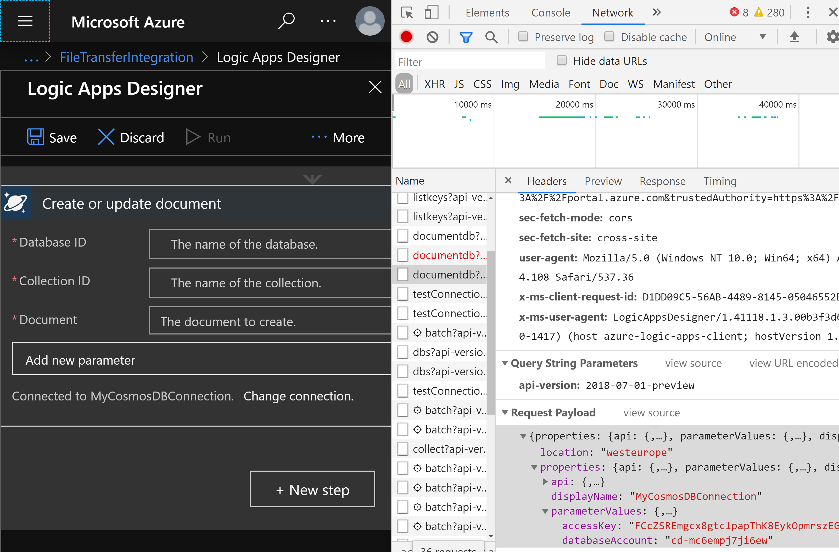
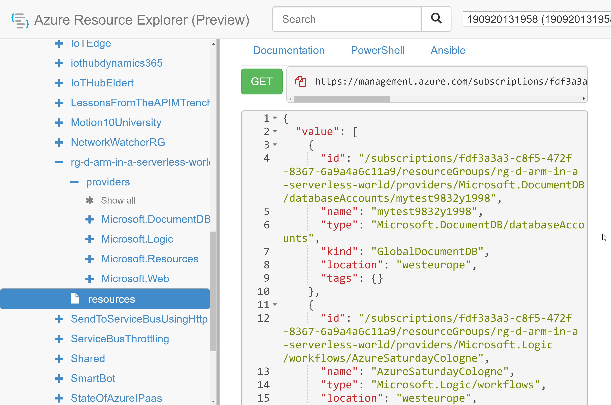
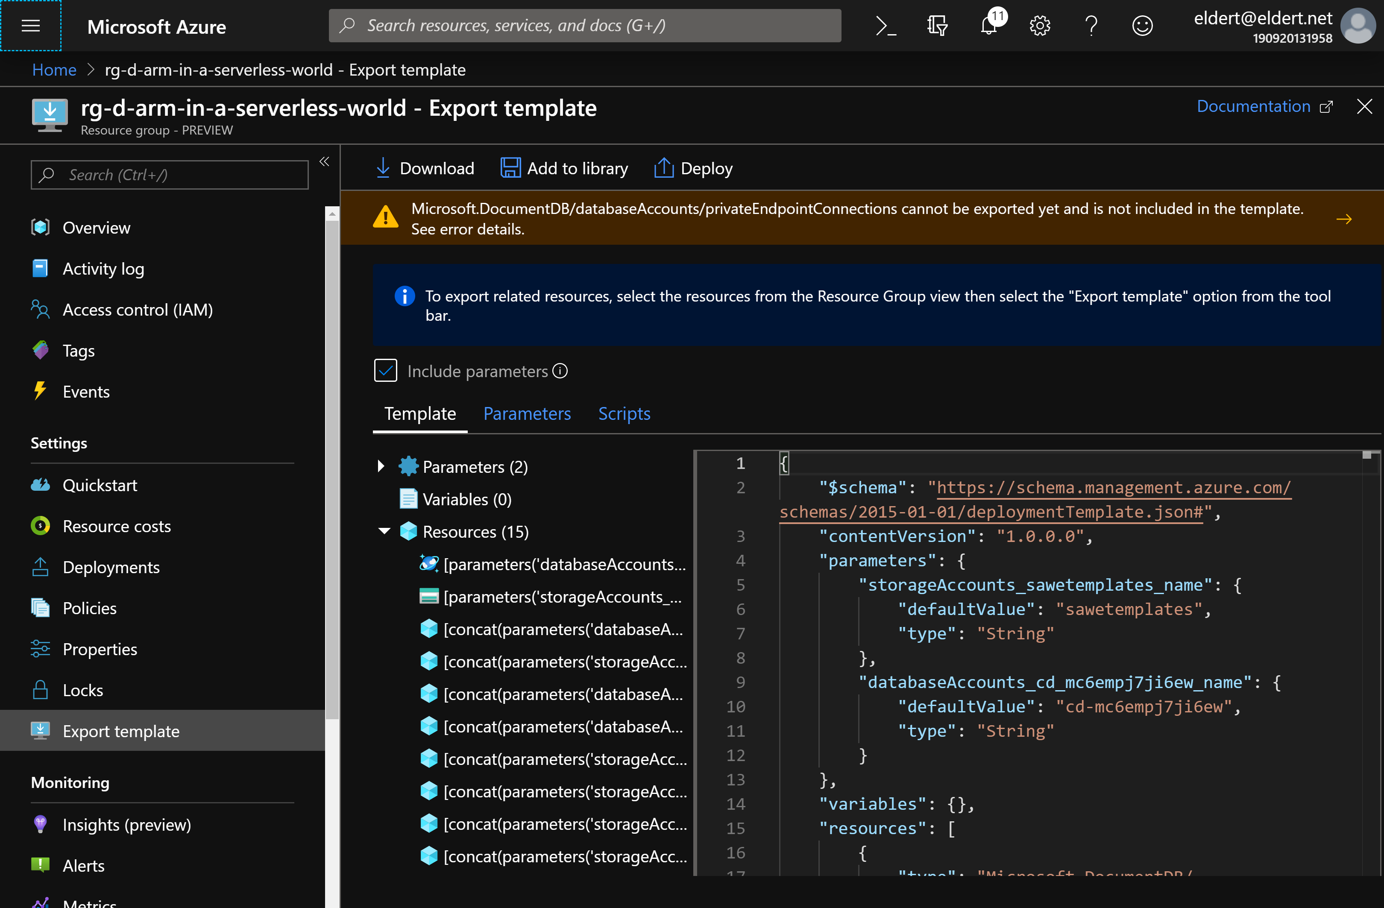
Extracting templates
Portal
Creation
Resource Explorer
Debug tools
Tools
API Management
Logic Apps

Slide 20
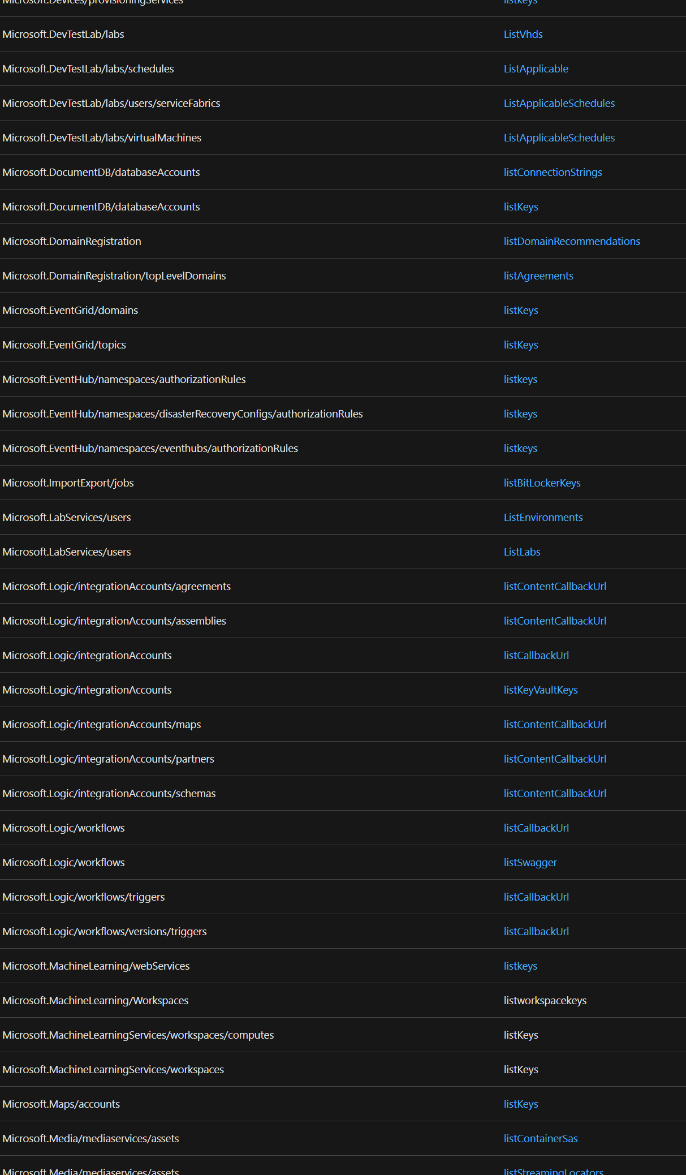
Secrets in templates
Securestring
Listkeys
Listsecrets
Key Vault
How about other settings?
List*

Slide 21
Deployment
Portal
PowerShell
Azure DevOps

Slide 22
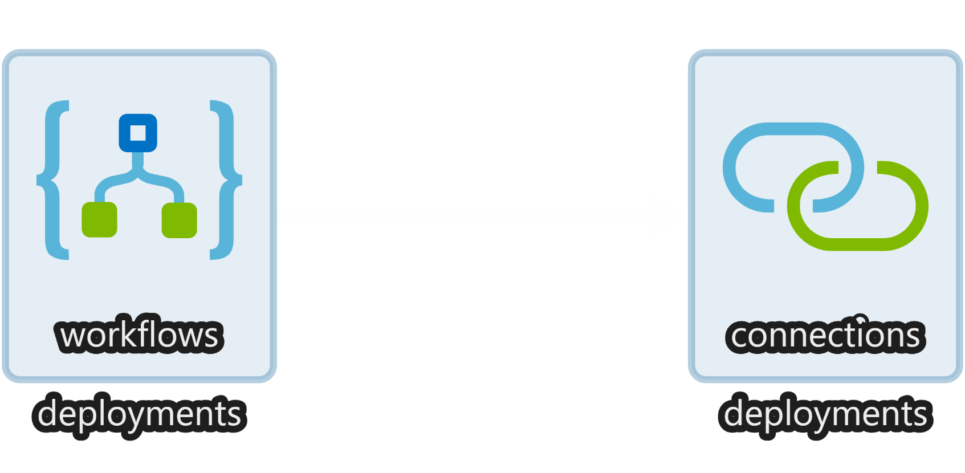


Demo
Notes:
30
Create Logic App with connection to Cosmos DB
Export using Visual Studio Code
Retrieve secret using listKeys in Connection.json
Create linked template which deploys both Logic App and Cosmos DB
Deploy through Azure DevOps

Slide 23

Quality assurance
Notes:
35

Slide 24
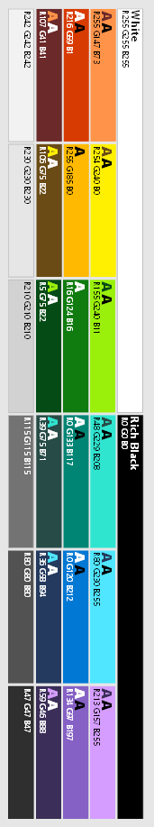
WhatIf
PowerShell
Calculates desired state
Retrieves current state
Noise suppression service
Calculated diff
Notes:
Input
ARM Template
Scope
Parameters
Mode

Slide 25
Azure Resource Manager Template Toolkit
Static Analysis for ARM Templates
PowerShell Core (& PowerShell)
Notes:
Static Analysis for ARM Templates
ARM-TTK
PowerShell Core (& PowerShell)
Preview Release
Currently Running on AzDO Pipelines (QuickStart Repo & Azure Marketplace)

Slide 26
Deployment script
Run arbitrary script
Replace scripts in pipeline
Think idempotently
Not allowed at MS
Notes:
Run an arbitrary script during a template deployment
Can replace additional scripts in pipeline
Think Idempotently - write idempotent scripts
Not allowed at MS

Slide 27

Demo
Notes:
39
Make a change in the CosmosDB template
Show what changes using WhatIf
Optional: Explain how to clean up the template
Optional: Use ARM toolkit to detect errors in template

Slide 28

Almost done…
Notes:
43

Slide 29
Take aways
Implement resources as IaC
Follow best practices
VS Code is your friend
Automate everything
Keep improving quality

Slide 30
Resources
New to ARM: aka.ms/justLearnARM
Link to all templates: https://azure.microsoft.com/en-us/documentation/templates/
GitHub: https://github.com/Azure/azure-quickstart-templates
Visual Studio Code Extensions: https://marketplace.visualstudio.com/VSCode
Template Toolkit: https://aka.ms/arm-ttk
Latest release: https://aka.ms/arm-ttk-latest
Previews: aka.ms/ARMTemplatePreviews
Best practices: https://github.com/Azure/azure-quickstart-templates/blob/master/1-CONTRIBUTION-GUIDE/best-practices.md

Slide 31

@egrootenboer
Notes:
43

